Slide 1
Starting a Walking Program
Presented by:
Cameron Lievense, MS
Worksite Wellness Coordinator
Shasta County HHSA Public Health Branch

Slide 2
Personal Background

Slide 3
Healthy Shasta
Mission: Partnering with the community to promote healthy eating and physically active lifestyles through environmental, policy, and organizational changes.
Vision: A community where the healthy choice is the easy choice.
Our goals include:
Increase fruit and vegetable consumption
Decrease consumption of sugary beverages
Increase walking and bicycling
Increase fitness and play

Slide 4
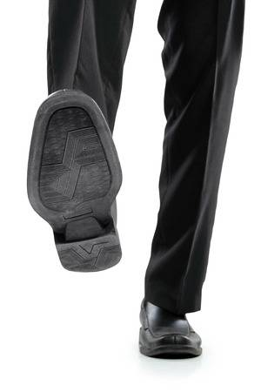
Walking
An apple a day keeps the doctor away,” but what about a walk a day?
Most underrated form of exercise.

Slide 5
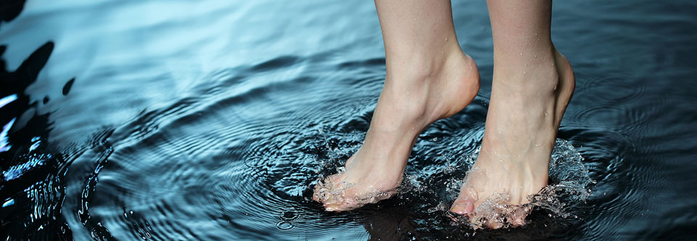
Walking Convenience
Can be done anywhere
No gym membership required
No equipment or special training

Slide 6
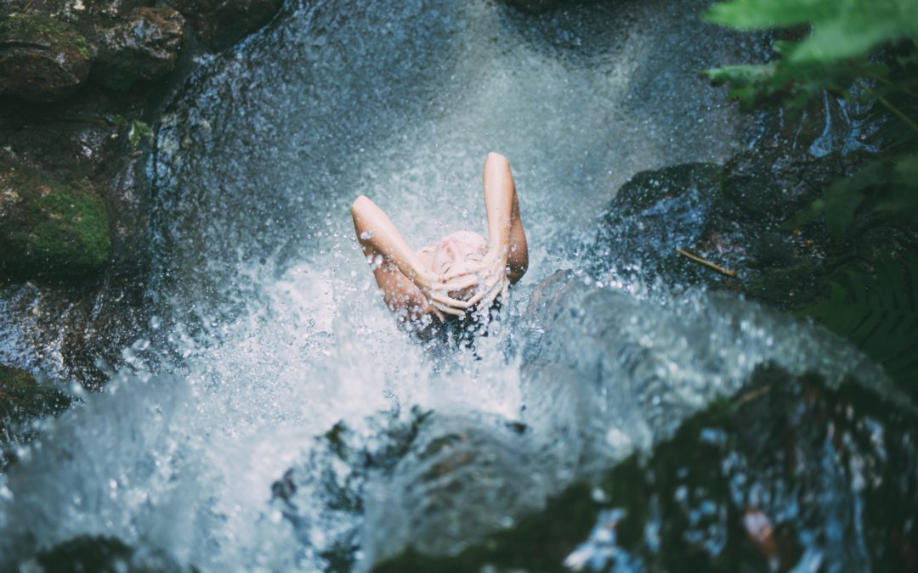
Some health experts have deemed walking to be the fountain of youth- just 30 minutes a day can change your life, or even save it.

Slide 7
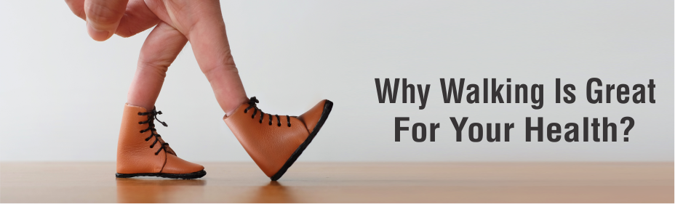
Walking- Physical Benefits
Taking regular, brisk walks can:
Improve heart health
Aid in weight loss
Regulate blood pressure
Improve circulation
Fight Cancer
Reduce risk of diabetes
Strengthen bones and muscles
Boost immune function
Improve digestion
Delay aging

Slide 8
Walking- Mental Benefits
Taking regular, brisk walks can:
Reduce stress
Boost creativity
Increase self-esteem
Increase energy
Improve sleep

Slide 9
Walking is Fun
To some people, exercise feels like a chore. With walking, you can pamper yourself in multiple ways.
You can do it with others
You can get “me” time
You can enjoy a dose of nature
You can gain a new perspective
You can be more creative

Slide 10
Walking Prescription
150 minutes per week of moderate aerobic activity
30 minutes a day, 5 days a week (can be broken down into 10 minute durations)
Weight Loss- 60 minutes a day recommended

Slide 11
12-Week Walking Schedule Sample
Week | Warm-up | Brisk walking | Cool-down
1 | 5 minutes | 5 minutes | 5 minutes
2 | 5 minutes | 7 minutes | 5 minutes
3 | 5 minutes | 9 minutes | 5 minutes
4 | 5 minutes | 11 minutes | 5 minutes
5 | 5 minutes | 13 minutes | 5 minutes
6 | 5 minutes | 15 minutes | 5 minutes
7 | 5 minutes | 18 minutes | 5 minutes
8 | 5 minutes | 20 minutes | 5 minutes
9 | 5 minutes | 23 minutes | 5 minutes
10 | 5 minutes | 26 minutes | 5 minutes
11 | 5 minutes | 28 minutes | 5 minutes
12 | 5 minutes | 30 minutes | 5 minutes
Based on National Heart, Lung, and Blood Institute

Slide 12
Starting a Walking Program
You’ve been walking for years. If you have kids, you helped them learn to do it. So what in the world don’t you know about walking?
When you start walking for health, you may find there are actually a lot of points you’ve never considered.

Slide 13
Where to Walk
Outdoors:
Neighborhood
Downtown
Open-air shopping complexes
Parks and trails
Tracks
Indoors:
Malls
Inside your home
Gym or fitness center
Work
“No matter what your preference is, the most important thing is that you walk consistently.”

Slide 14
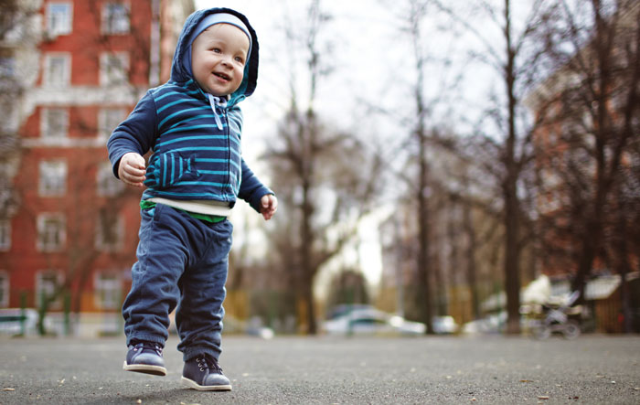
Types of Walking
Everyday walking
Leisure walking
Fitness walking
Interval walking
Hiking
“All walks are good for you. But there’s more than one way to walk.”

Slide 15
Mindful Walking
To reduce stress and be more present in the moment.
The goal is not to go faster or get a better workout. The focus is on calming down, reducing stress, and relaxing.
Tips
Bring attention to the sensations in the body
Breathe in smoothly through nose taking deep breaths. Feel lungs expand top to bottom vs just top
Engage full senses. Notice each sight, touch, and sound

Slide 16
“By learning to focus on the here and now, you may find yourself less likely to get caught up in worries about the future or regrets over the past.”

Slide 17
Walking Groups
Members
Meeting
Guidelines
Goals
Motivation
Existing Groups
How to Start a Walking Group

Slide 18
HealthyShastaWalks.org
Local walking guides
Find places to walk and people to walk with

Slide 19
Local Trail Maps
Visit: HealthyShasta.org/maps/

Slide 20
Walktober Challenge
For Questions, contact WalktoberChallenge@gmail.com
HealthyShasta.org/be-active/Walktober/

Slide 21
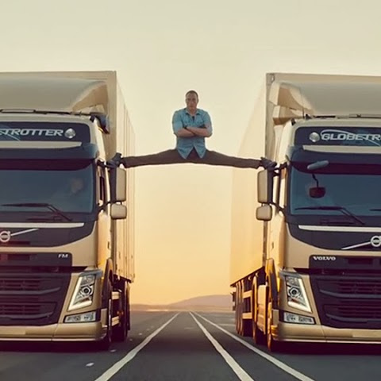
Stretching- Active vs Passive
Active
No external force being provided
You are actively moving one muscle group to stretch another
Passive
External force being provided
You are being stretched instead of actively stretching
Tip: Start with Active Stretch. End with Passive Stretch.

Slide 22
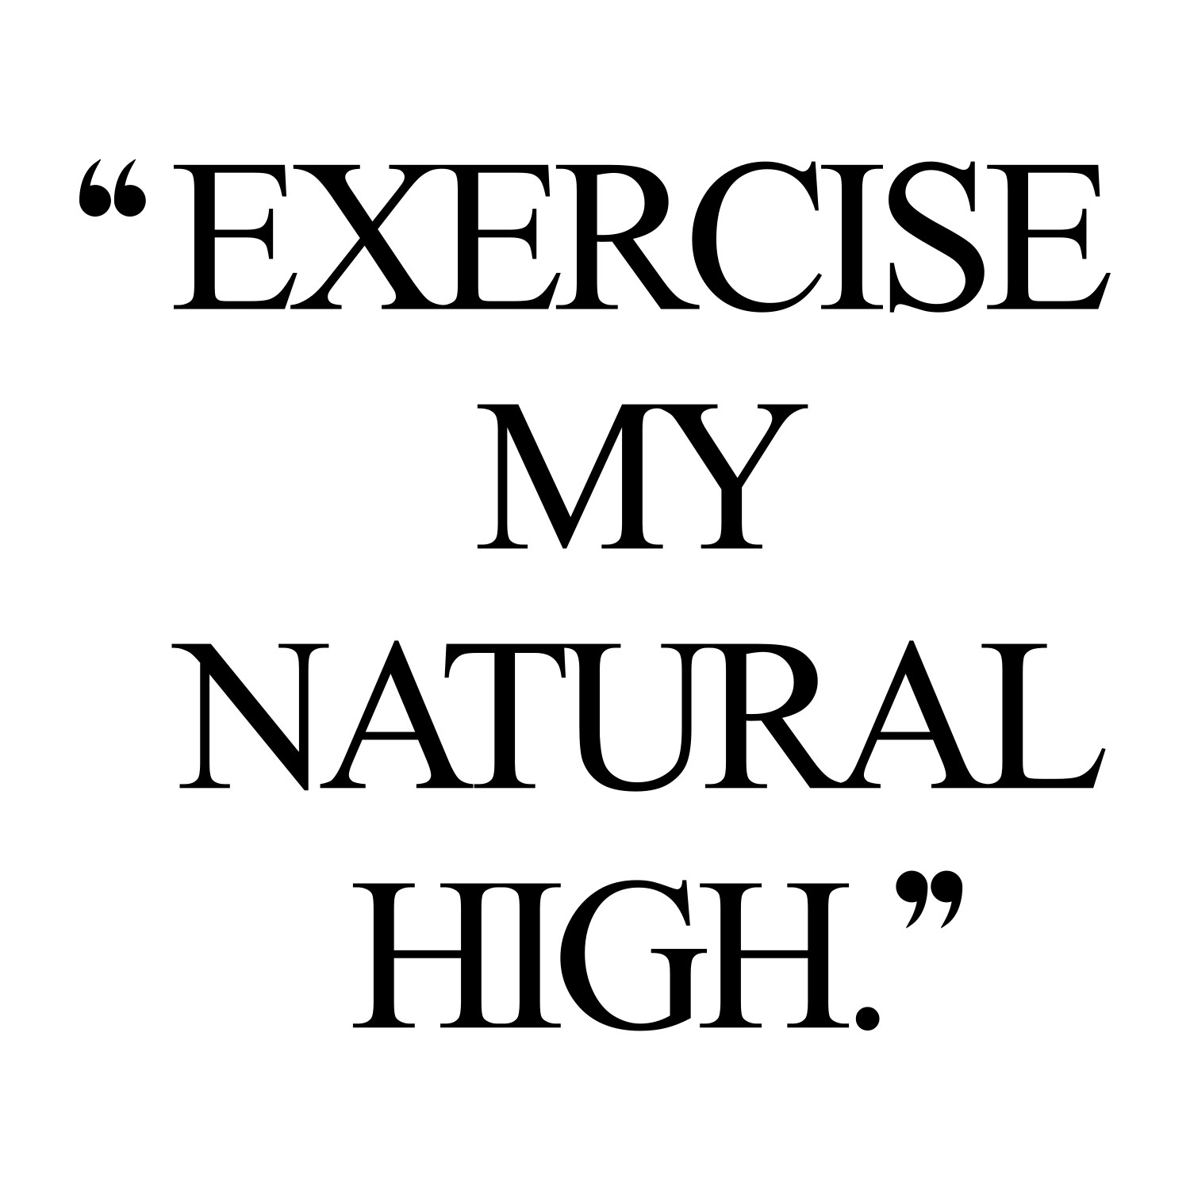
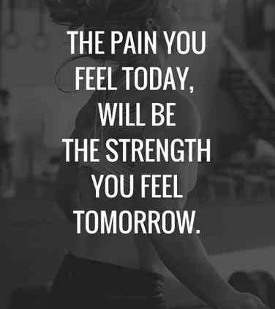
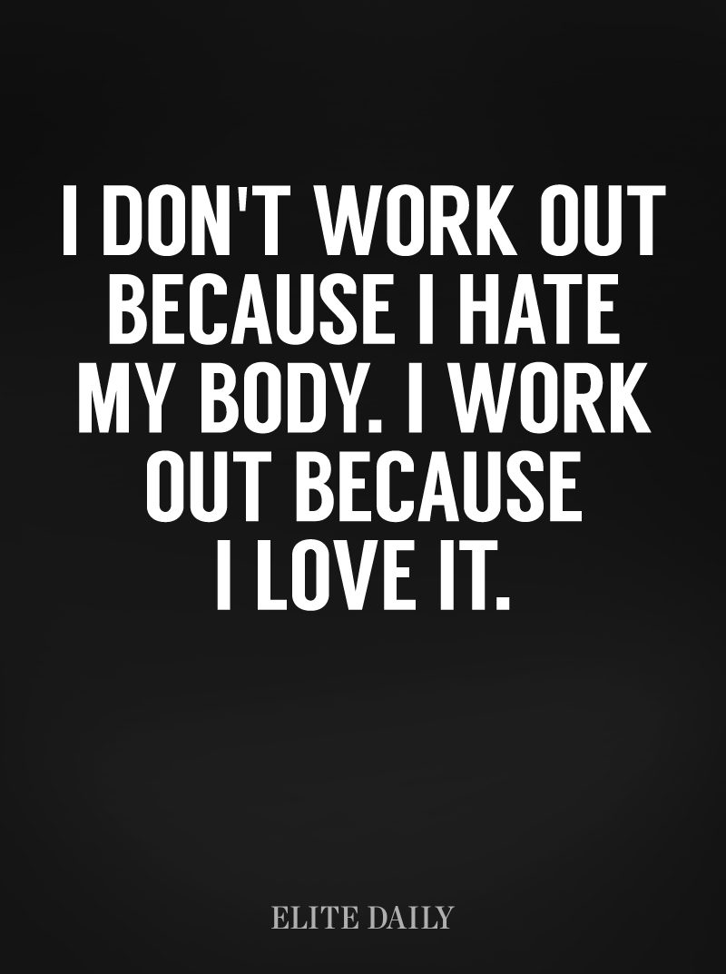
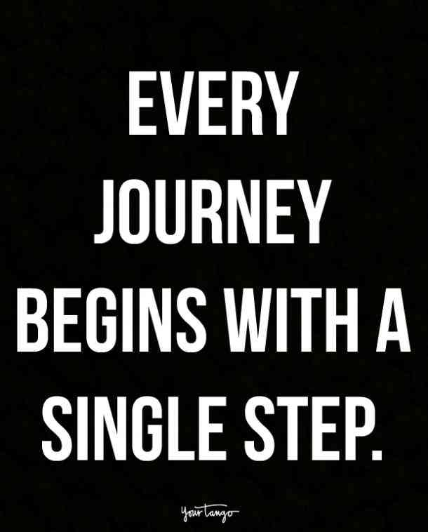
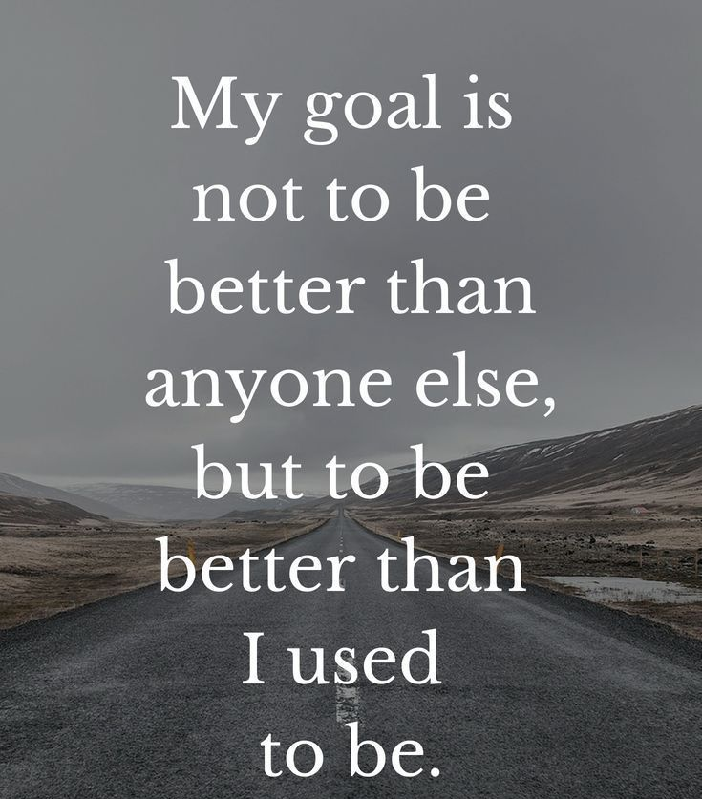

Slide 23
Questions?
THANK YOU!
Cameron Lievense
clievense@co.Shasta.ca.us
530-229-8456

